Slide 1
Progress on solving 1D GPE
2021. 02. 25 kT

Slide 2
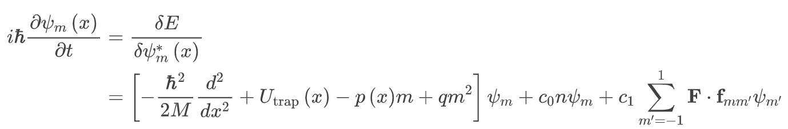
Why do I solve GPE?
Support possible 1D jet experiments
Explain and get insights on spinor experiments
Complement Bogoliubov analysis (remnant bec dynamics)
Understand numerics people’s job

Slide 3
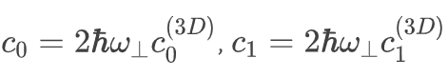
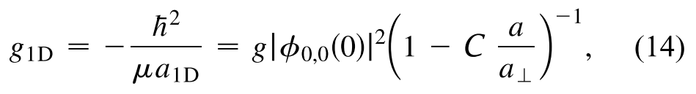
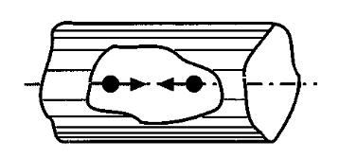
Quasi-1D problem
Li7 is good element to study 1D mean-field regime due to the small a. Accordingly, bad for TG gas unless we use Feshbach
Assumed mean-field 1D regime
Need to renormalize the interaction coefficient
10.1103/PhysRevLett.81.938

Slide 4
Structure of the simulation
Set parameters
Find ground state with initial parameters
Impose noise seed for instability
Evolve dynamics with quench parameters
Save parameters and data
Can skip #2

Slide 5
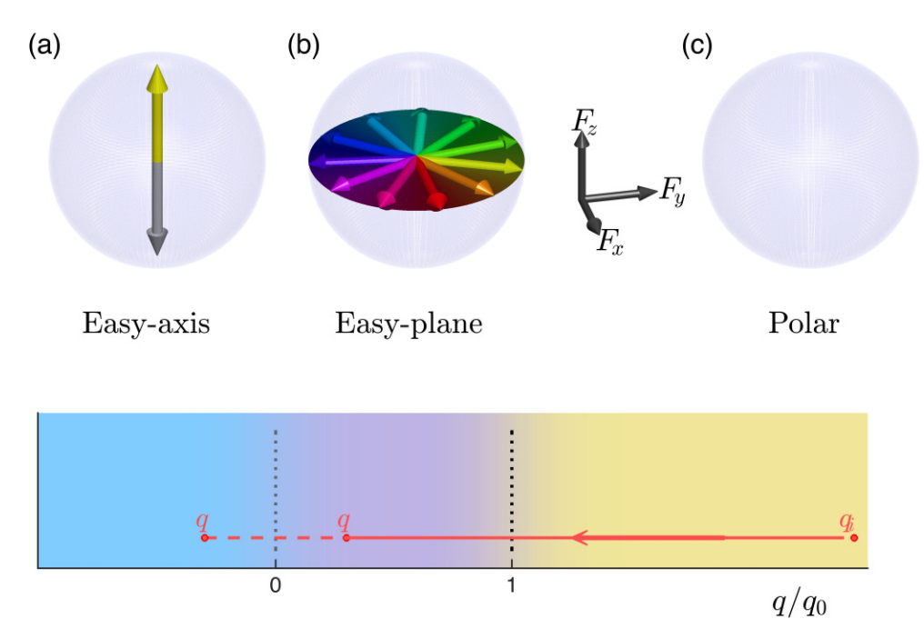
Finding the ground state
Imaginary time evolution method
Excitation decays exponentially when H → iH
Local minimum issue present but good enough for spinor (simple ground state)
10.1103/PhysRevA.94.023608

Slide 6
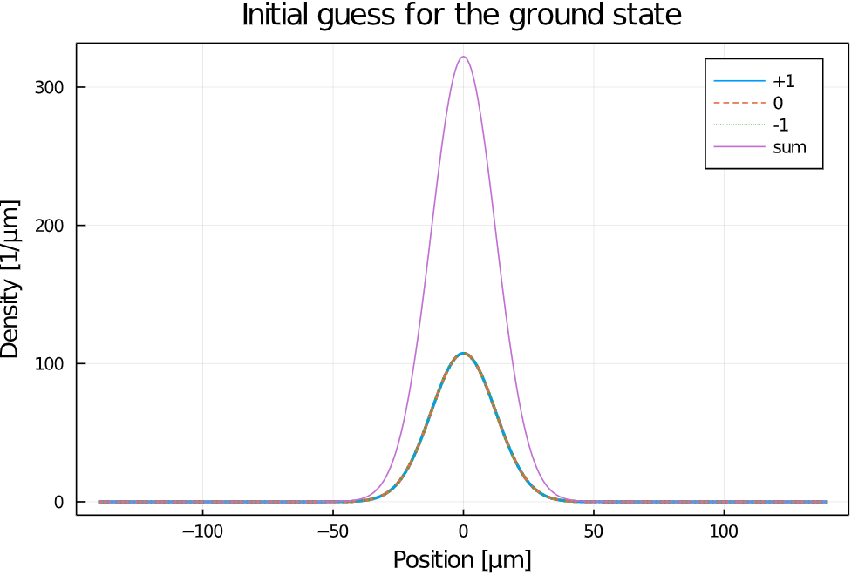
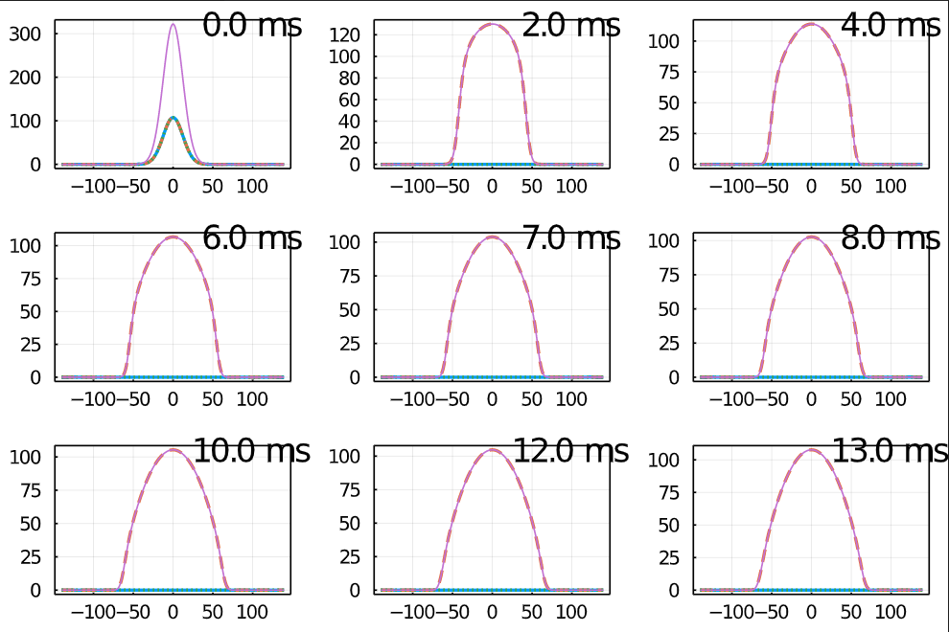
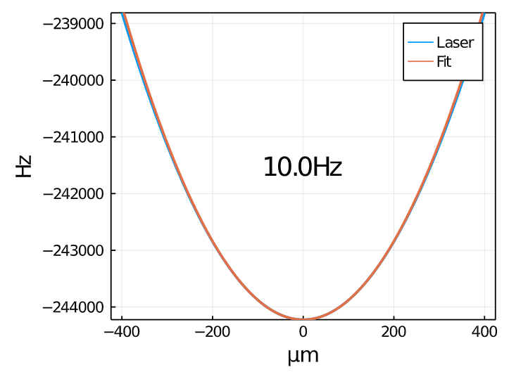
(c) Polar phase ground state
f = (10Hz, 1.2kHz)
N = 1e4
q = 1kHz c1n = -77Hz
ODT: 30um waist, 300mW

Slide 7
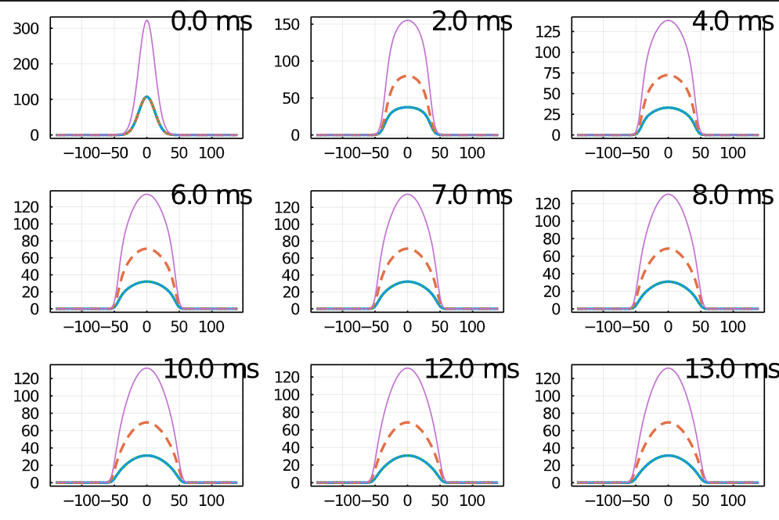
(b)
f = (10Hz, 1.2kHz)
N = 1e4
q = 10Hz
p = 0
c1n = -77Hz

Slide 8
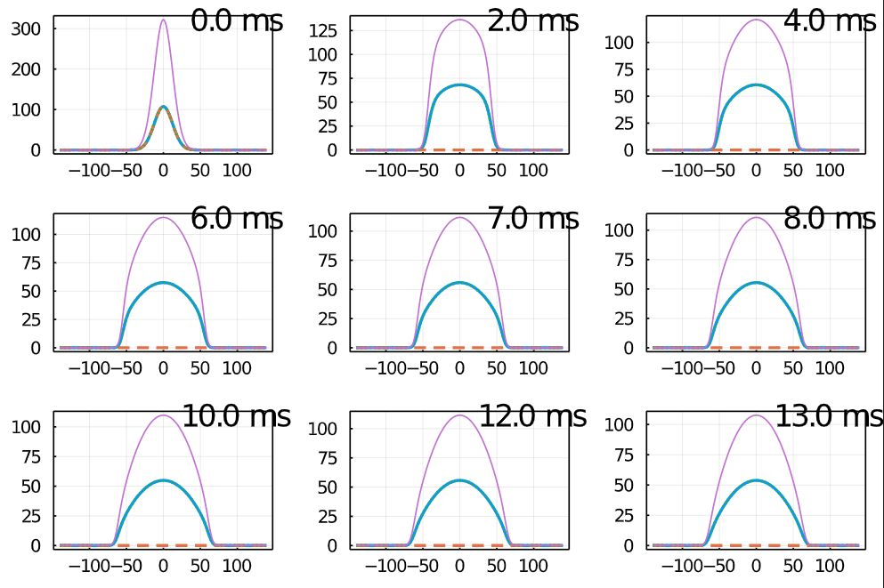
(a)
f = (10Hz, 1.2kHz)
N = 1e4
q = 10Hz
p = 0
c1n = -77Hz

Slide 9
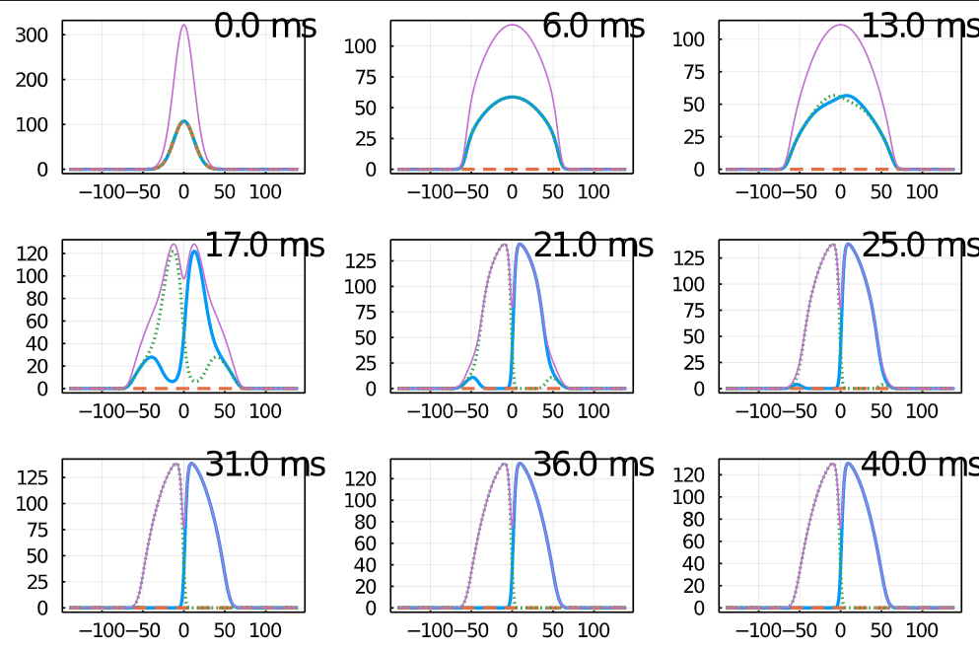
(a) With small gradient (0.1mG/cm)
The gap is insensitive to the amount of the gradient
interaction effect
There is initial condition dependence due to the SSB

Slide 10
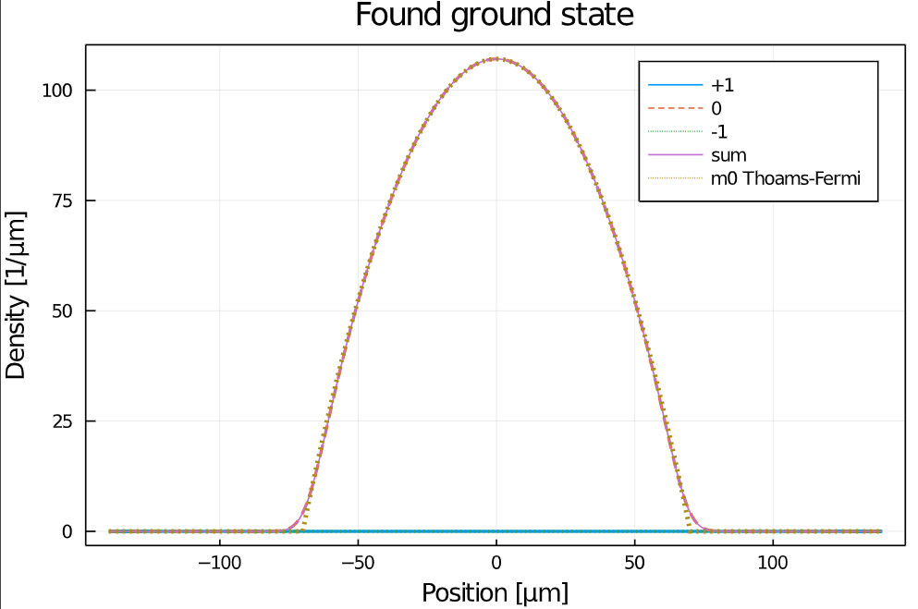
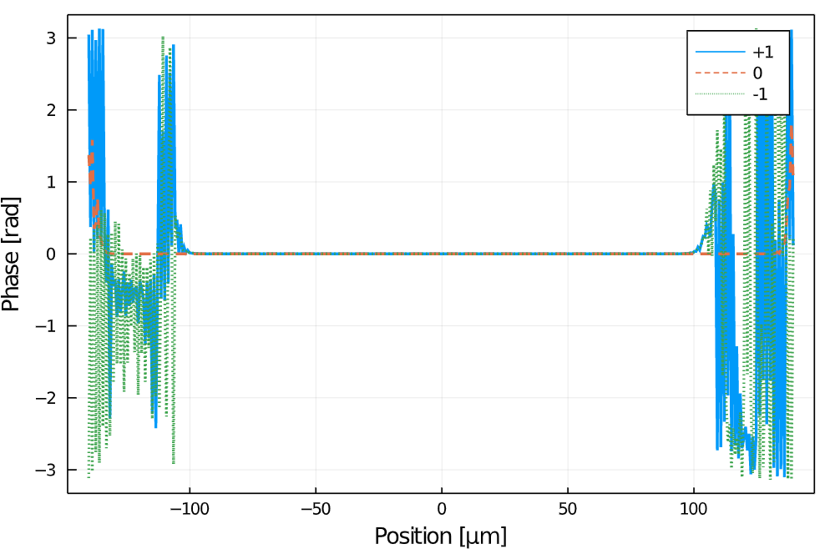
Quantitative validity for polar phase

Slide 11
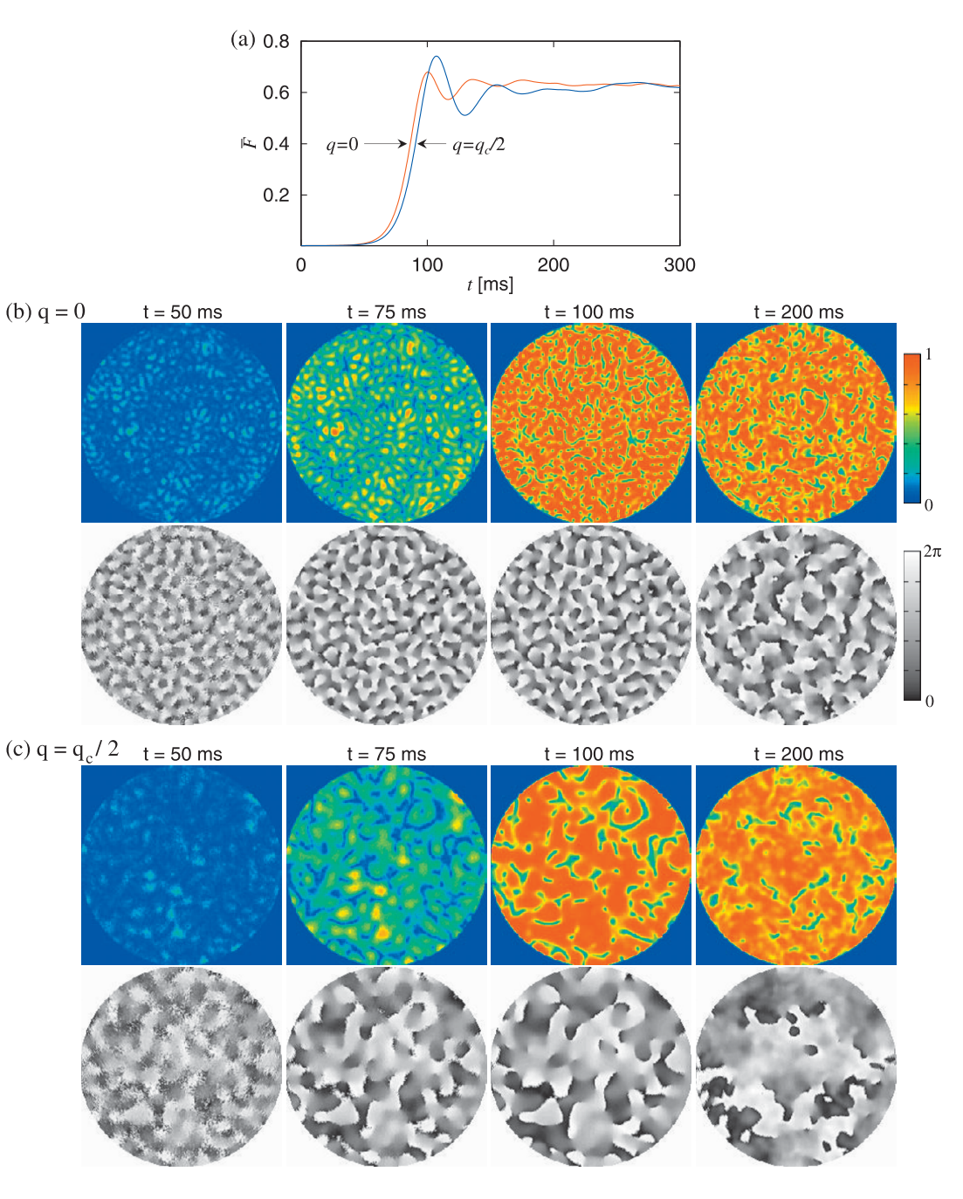
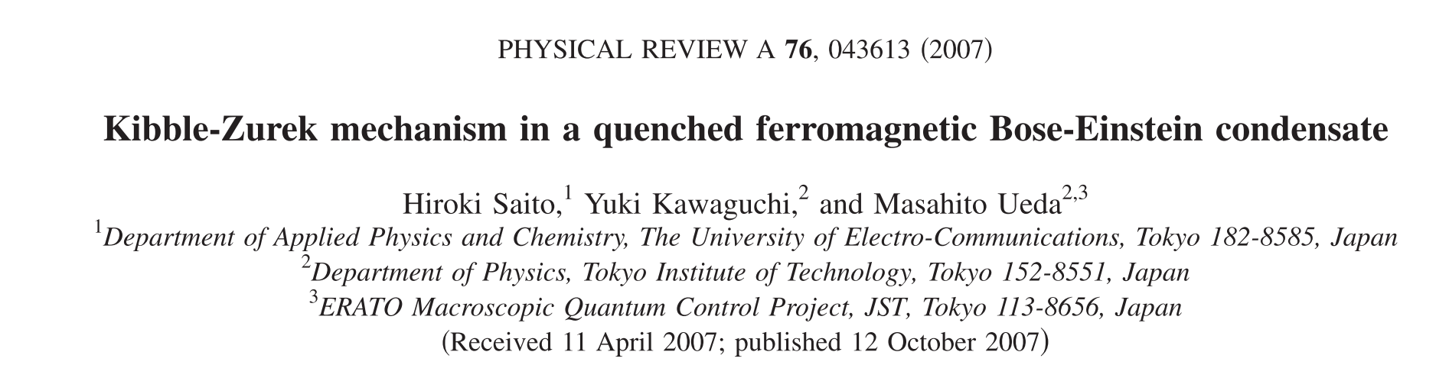
Dynamics; reproducing Saito et al (2007)
There is 1D version calculation!
The system size is quite large (~300um) and long term dynamics is been calculated

Slide 12
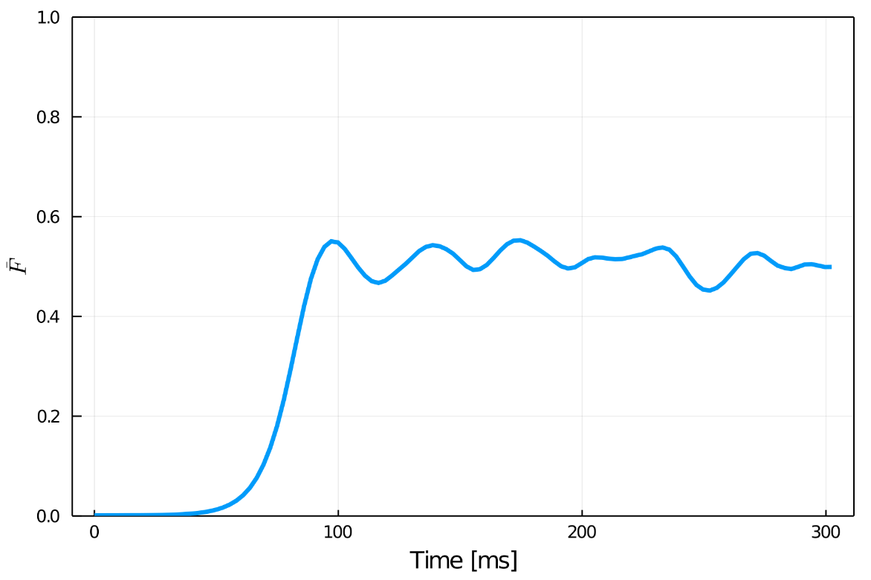
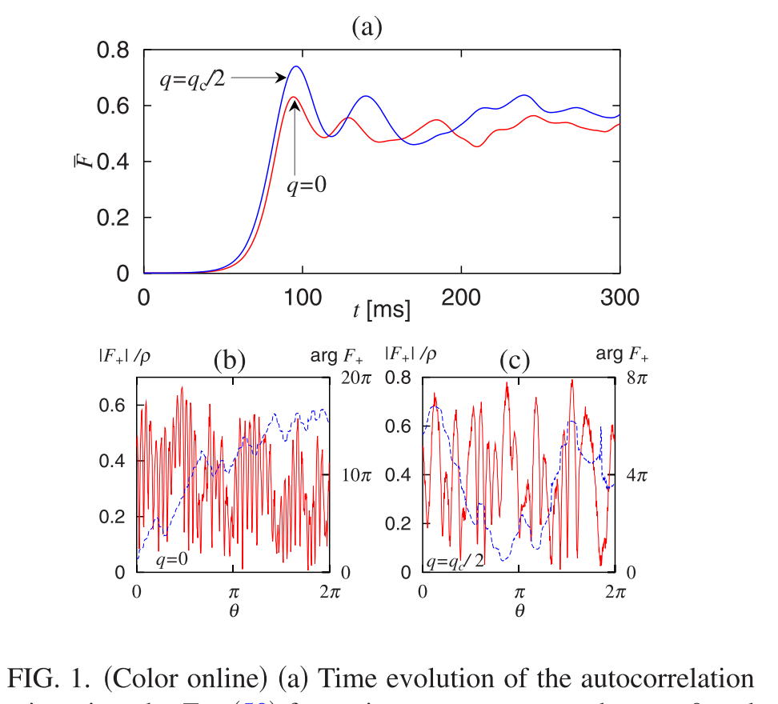
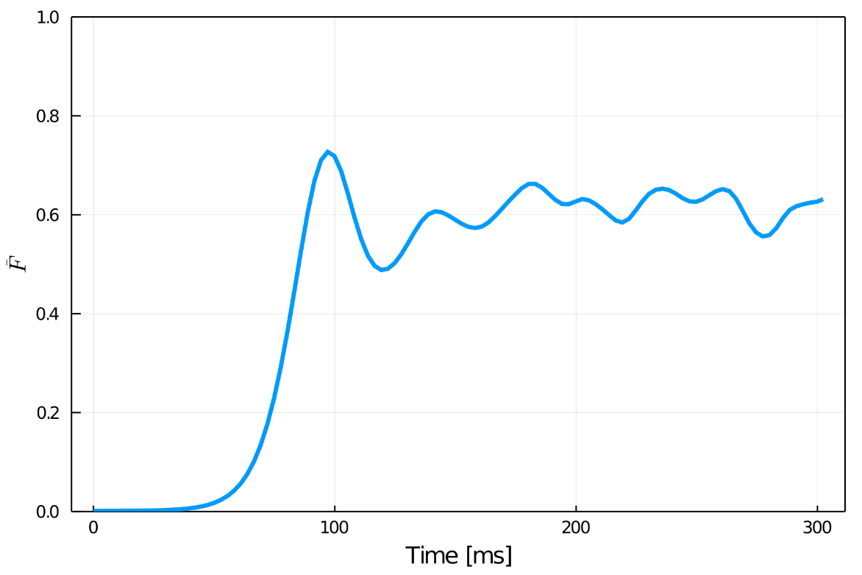
Comparison on 1D calculation
q =0
q =qc/2

Slide 13
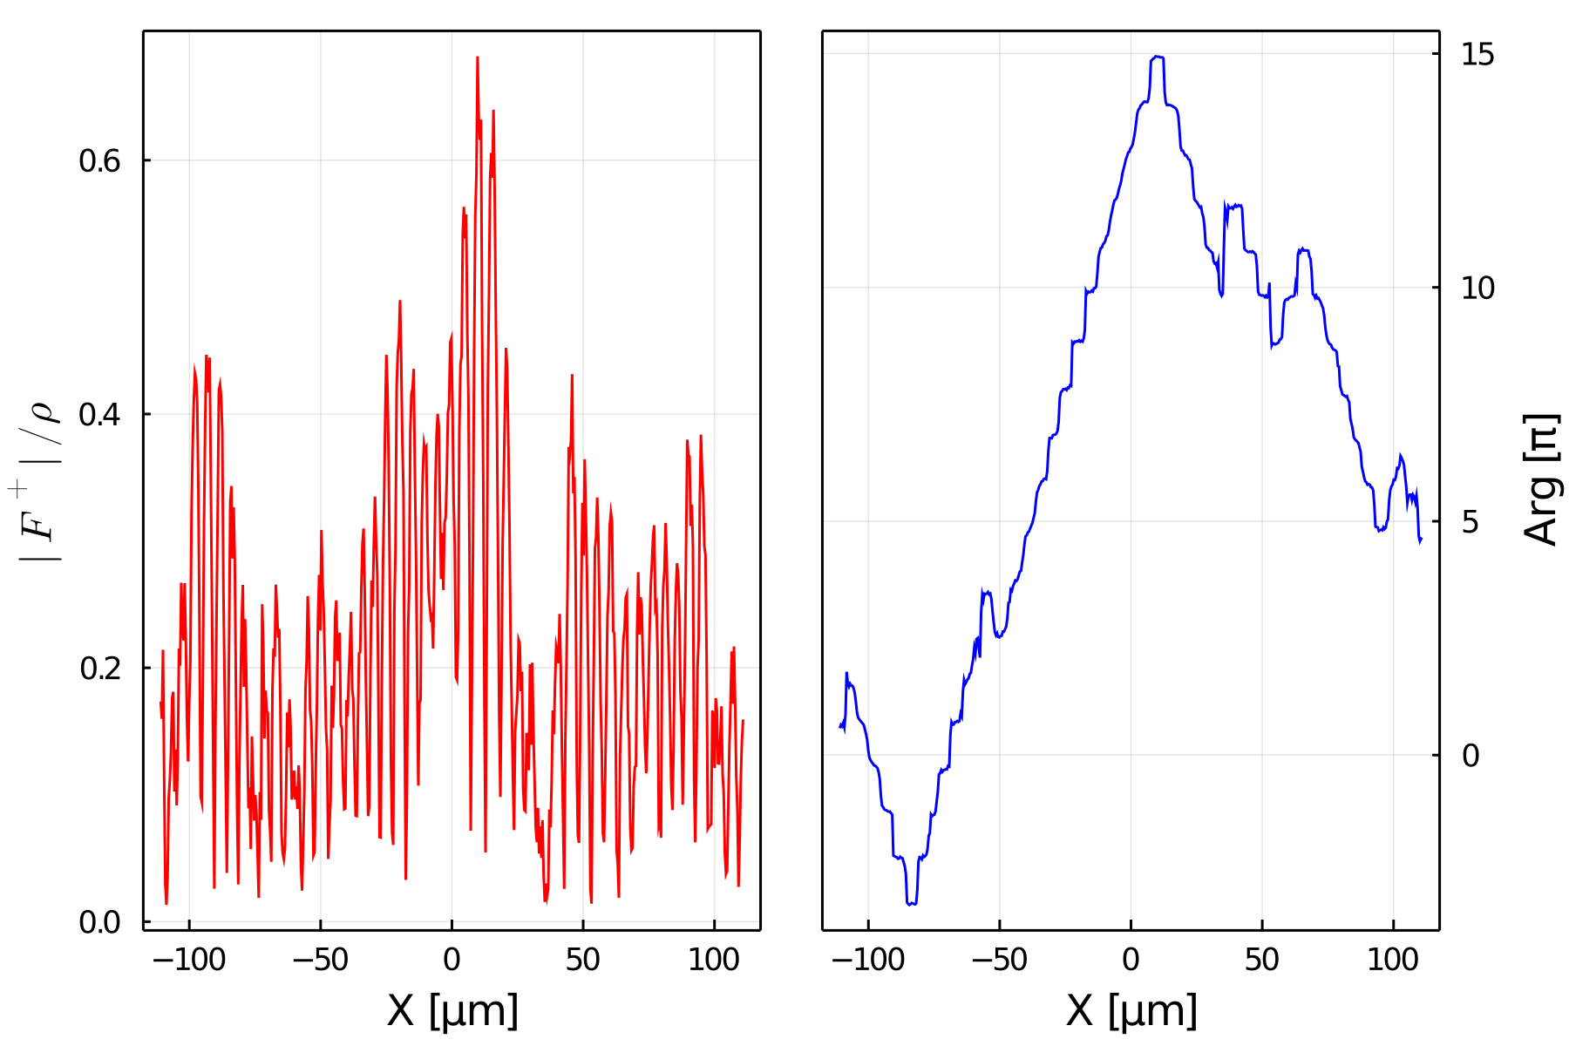
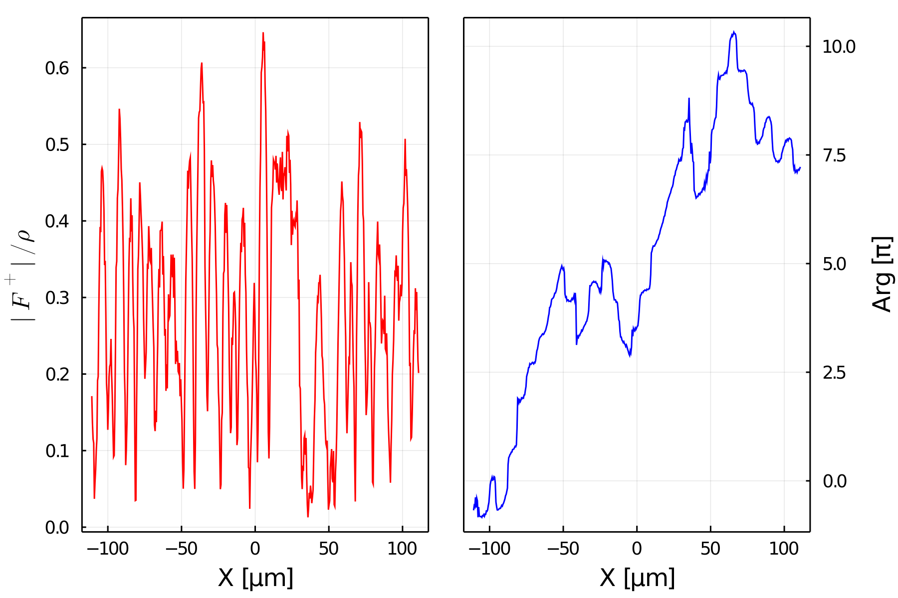
Comparison on 1D calculation
q =0
q =qc/2

Slide 14
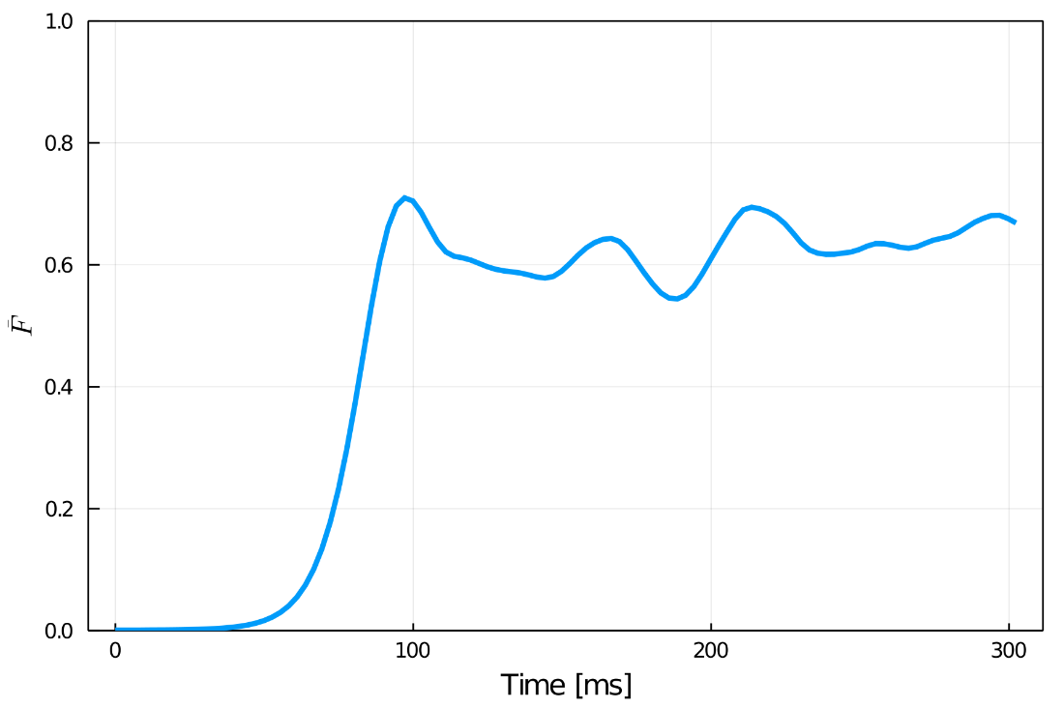
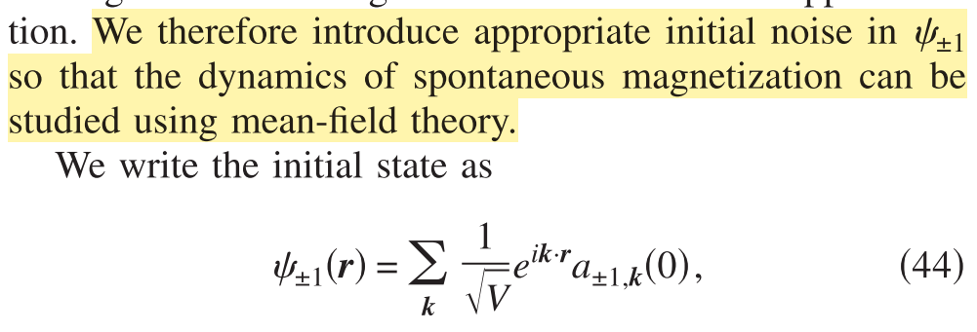
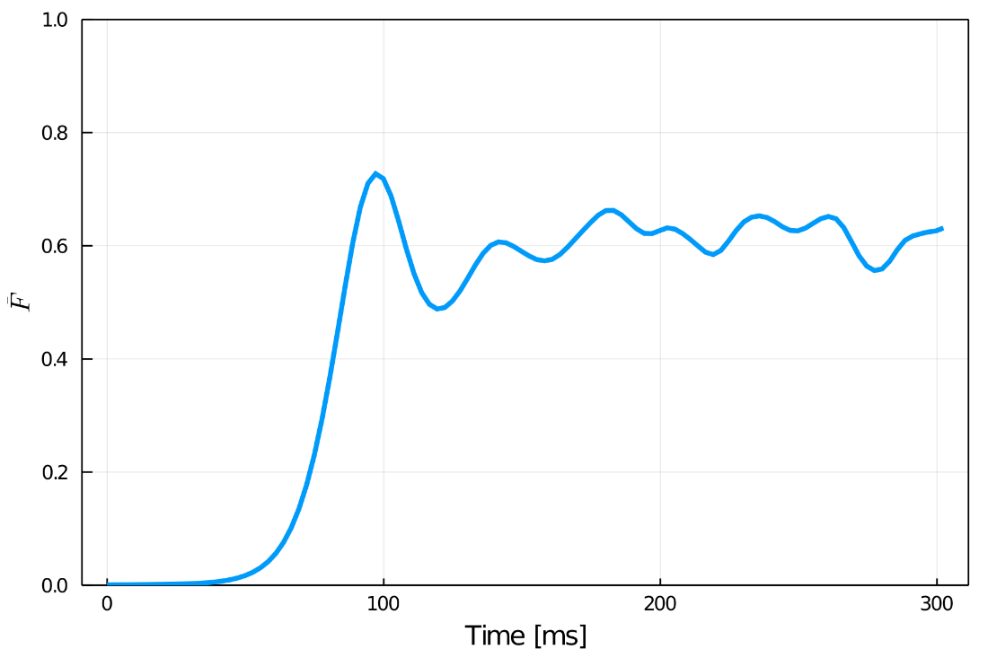
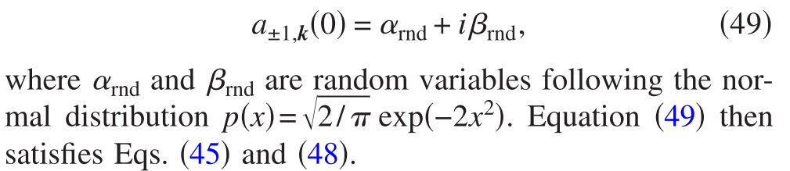
Discussion
Same calculation with different random number
Result reproduced within the random number uncertainty

Slide 15
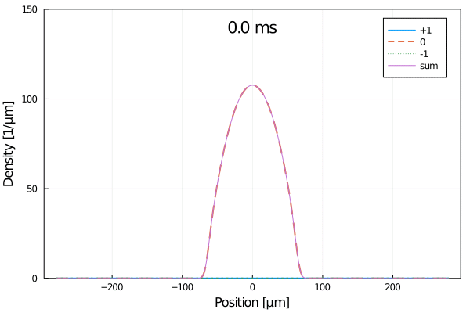
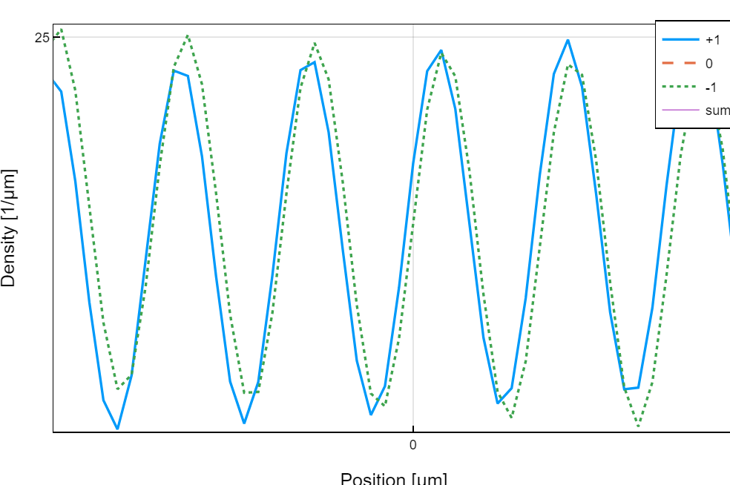
Jet formation
f = (10Hz, 1.2kHz)
N = 1e4
p = 0
c1n = -77Hz
q = 1kHz → -1kHz

Slide 16
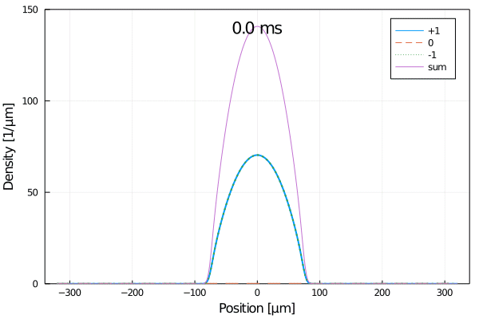
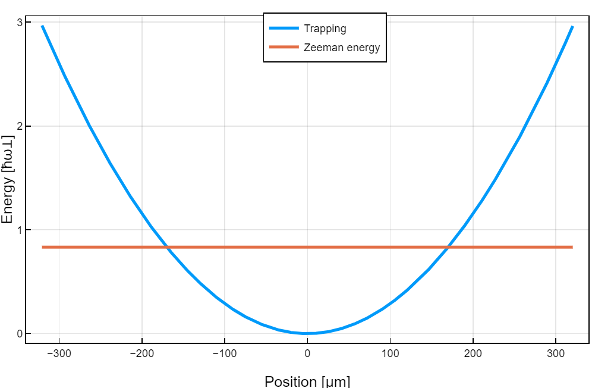
Jet formation
f = (10Hz, 1.2kHz)
N = 1.5e4
p = 0
q = -2kHz → 1kHz

Slide 17
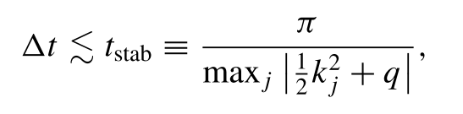
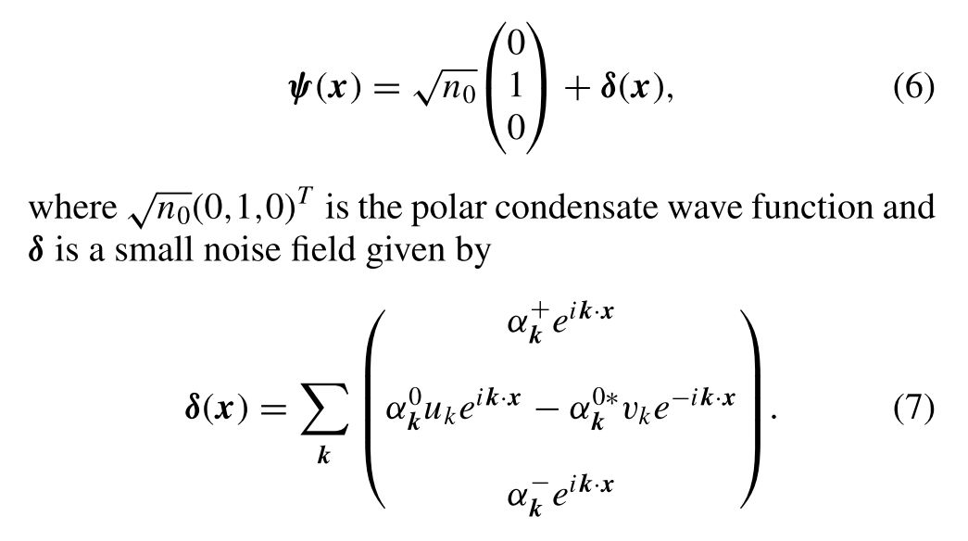
Issues
It is slow for jet exp. It takes ~10mins for 2e3 grid (20dx ~ sqrt(h^2/2mq)). Other cases are comparable to GPELab (single component).
Perhaps there is a fundamental reason (parameters are unusual)
Simulations are initial seed insensitive (though I used proper method for reproducing Saito et al) but still there is dependences. → Implement a proper way to include with the aid of Bogoliubov theory
Kinetic part stability criteria (generic for Schrodinger eq), unless we go spectral method
10.1103/PhysRevE.93.053309
10.1103/PhysRevA.94.023608

Slide 18
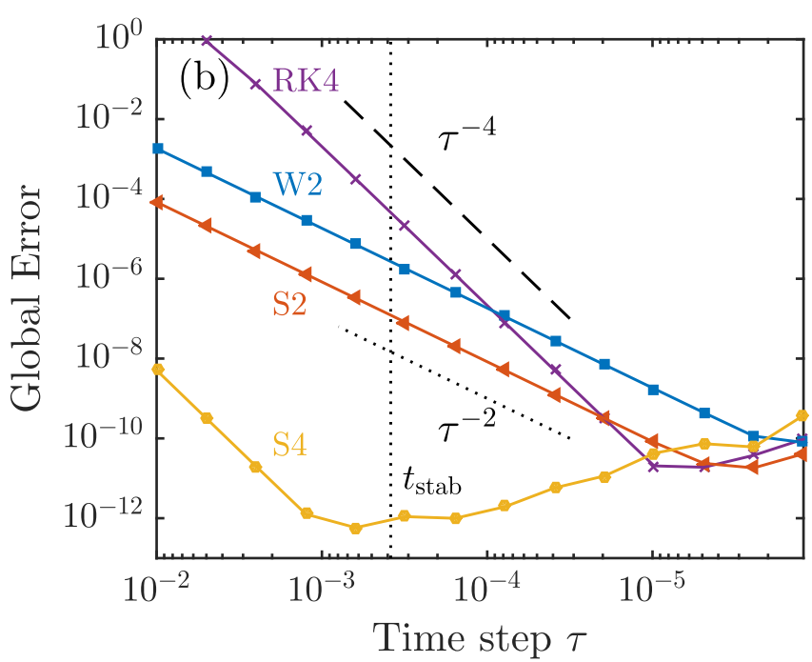
Next,
Move the focus on the quantum correlation of the jets
On GPE simulation
- Keep checking the validity, especially for high q and the seed
- Time-of-flight implementations (straightforward)
- Human readable program (I believe it is already good)
- Implementing 1D version of SJ’s experiment
- Advanced algorithms (Otago; Symes, PRE(2016), need some restriction)
Now we can solve GPE, how about OBE?
→ understanding abs imaging and maybe Raman
GPU for 2D extension in the future?
Including dissipation?

Slide 19
End

Slide 20
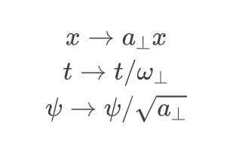
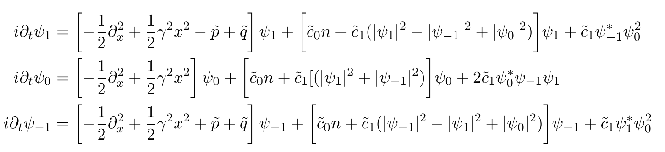
Dimensionless GPE
Numbers like hbar can lead round-off error.
I normalize all the scales with radial trapping frequency

Slide 21
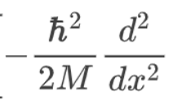
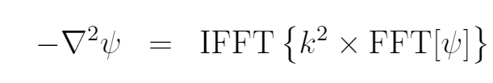
Some remarks on calculation algorithm
Integration is nothing but a variant of RK4.
Calculating the kinetic energy term can be tricky (if we use finite difference method).
Method I have used is kind a primitive. There are some advanced algorithms (like that of Otago)

Slide 22



Languages and packages
And many others packages

